Slide 1



AI- Based Training an Assessment Tool For Vocational Education
24-25J-185

Slide 2



OUR TEAM
Vilajini.Y
IT2118928
Sujeevan.R
IT20657314
Niles A.P
IT21347726

Slide 3

Introduction
Background
Research Problem
Objective
Overall System Diagram

Slide 4
AI offers scalable, personalized, and engaging solutions.
Enhances assessment and feedback processes.
Modernizes vocational training to align with industry demands
Background
Difficult to expand traditional training methods.
Significant time and resources required for managing vocational training.

Slide 5
Traditional vocational training methods follow a one-size-fits-all approach, failing to meet individual student needs
Students often lose interest in vocational training due to the lack of interactive and immersive learning experiences.
Research Problems
Traditional assessment methods are slow, leading to delayed feedback that impacts student learning and skill development.
Vocational training programs often fail to keep up with rapidly changing industry demands, leading to outdated skillsets.

Slide 6
Develop an AI-based training and assessment tool that transforms vocational education by providing personalized learning experiences, automating assessments with real-time feedback, and enhancing student engagement through gamification and interactive learning modules.
Main Objective

Slide 7
Intelligent Tutor and Automated Assessment System with AI-Viva Session
AI powered Virtual mentor and Support System
Sub Objectives
Skill-Based Adaptive and Personalized Learning Path Component
Gamification and Game-Based Learning for Vocational Education

Slide 8
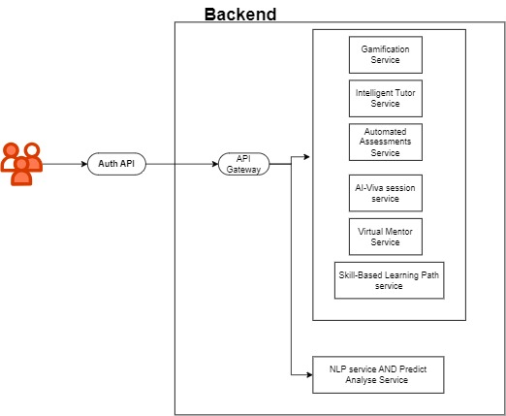
Overall System Diagram
IT21189258 | Vilajini.Y | 24-25J-185

Slide 9
Automated Assessment System with AI-Viva Session
It21189258
Vilajini.Y
Information Technology
IT21189258 | Vilajini.Y | 24-25J-185

Slide 10
Background
AI-driven viva sessions simulate real-world interview scenarios.
Provides comprehensive assessments beyond written exams.
Traditional assessment methods are manual and time-consuming.
IT21189258 | Vilajini.Y | 24-25J-185

Slide 11
Research Question
How can AI-driven automated assessments, including AI-Viva sessions, be developed to provide personalized, simulate realistic oral exams in vocational education?
IT21189258 | Vilajini.Y | 24-25J-185

Slide 12


Research Gap
Features | Traditional ITS | AI-Driven Assessment Systems | Proposed System
AI-Driven Viva Simulations
Comprehensive NLP for Assessment
Context-Aware Adaptive Learning
IT21189258 | Vilajini.Y | 24-25J-185

Slide 13
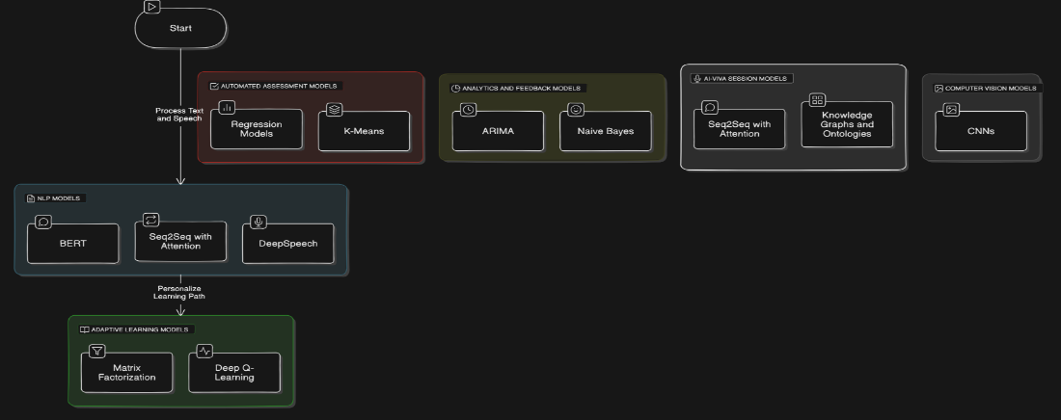
System Diagram
IT21189258 | Vilajini.Y | 24-25J-185

Slide 14


Tools and Technologies
Python
React Js
Django
PostgreSQL
Google Cloud Speech-To-Text-API
ChatGPT API for AI-Chatbot
IT21189258 | Vilajini.Y | 24-25J-185

Slide 15
Requirements
Functional Requirements
NON-Functional Requirements
User Authentication
AI-Viva Session
Performance Analytics
Content Management
Communication Module
Integration with External Systems
Security
Performance
Reliability
Scalability
Usability
Maintainability
Compatibility
Accessibility
Localization
Data Backup and Recovery
IT21189258 | Vilajini.Y | 24-25J-185

Slide 16
Achivements
Using API key for viva question
Done database schema
Halfly train the model for dynamical question and score.
IT21189258 | Vilajini.Y | 24-25J-185

Slide 17
Achivements
Using API key for viva question
Done database schema
Halfly train the model for dynamical question and score.
IT21189258 | Vilajini.Y | 24-25J-185

Slide 18
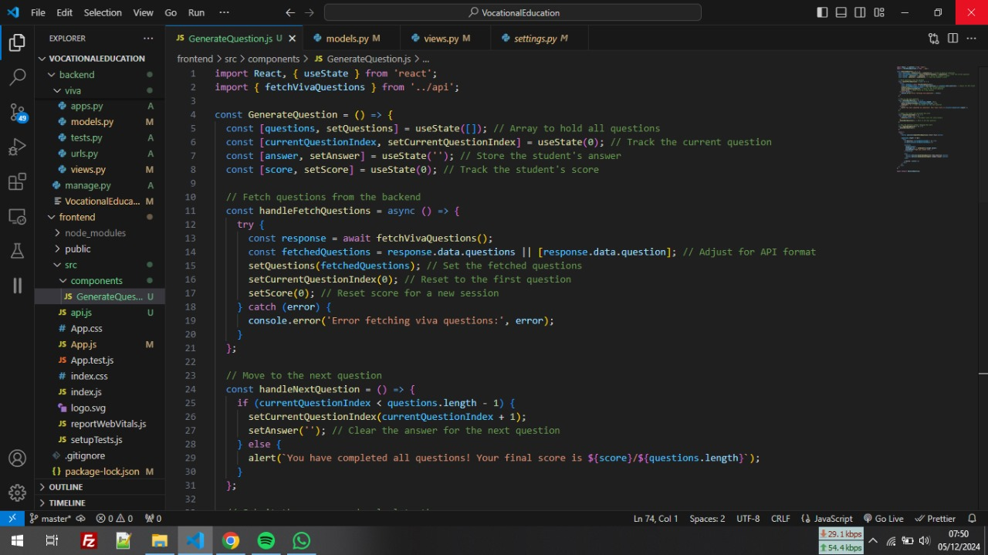
What Has Been Done
IT20656314 | Sujeevan.R | 24-25J-185

Slide 19
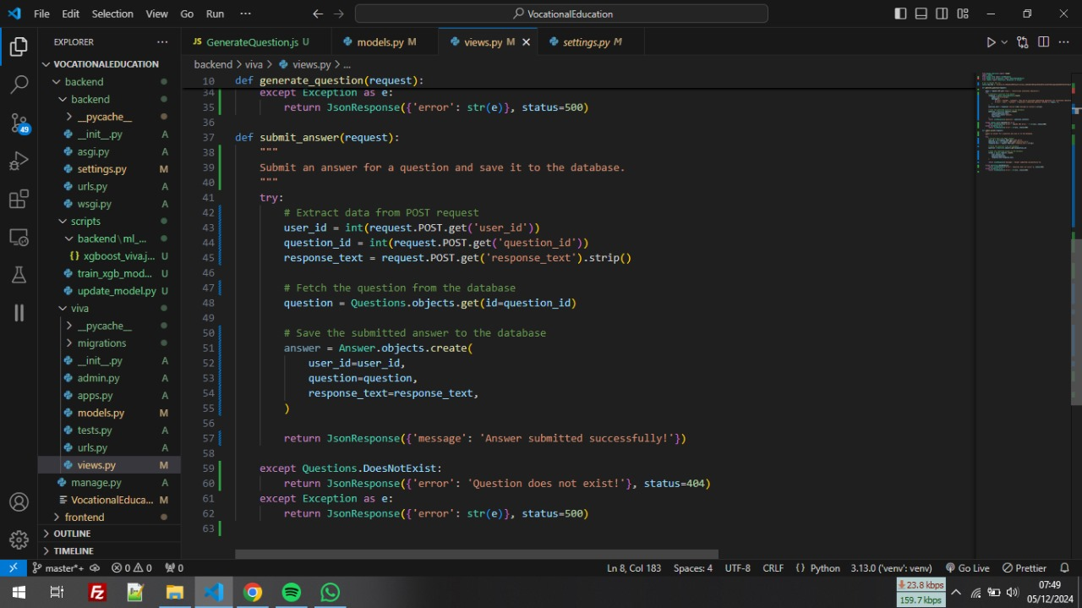
What Has Been Done
IT20656314 | Sujeevan.R | 24-25J-185

Slide 20
What Has Been Done
IT20656314 | Sujeevan.R | 24-25J-185

Slide 21
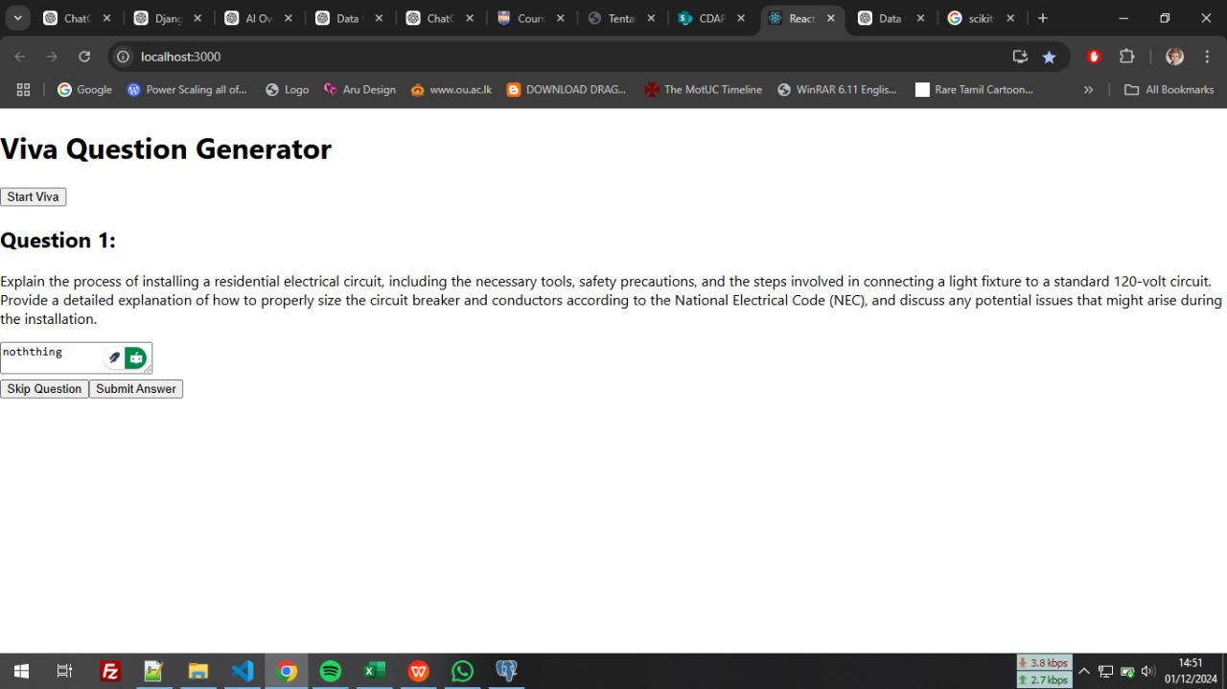
What Has Been Done
IT20656314 | Sujeevan.R | 24-25J-185

Slide 22
What to be Done
User Interface Development
Deploy Model
Reporting and Analytics
Improve Model Performance
Enhance Data Quality
IT20656314 | Sujeevan.R | 24-25J-185

Slide 23
References
Chassignol, M., Khoroshavin, A., Klimova, A., & Bilyatdinova, A. (2018). Artificial intelligence trends in education: A narrative overview. Procedia Computer Science, 136, 16-24.
Huang, G.-B., Zhu, Q.-Y., & Siew, C.-K. (2006). Extreme learning machine: theory and applications. Neurocomputing, 70(1-3), 489-501.
Jean-Charles, A. (2018). Internet of things in education: Artificial intelligence voice assistant in the classroom. Society for Information Technology & Teacher Education International Conference, 883-885.
Patrick, S., Kennedy, K., & Powell, A. (2013). Mean what you say: Defining and integrating personalized, blended and competency education. International Association for K-12 Online Learning.
IT21189258 | Vilajini.Y | 24-25J-185

Slide 24

AI powered Virtual mentor and Support System
It21188954
Saseena M.U.F
Information Technology
IT21188954 | Saseena M.U.F | 24-25J-185

Slide 25
Background
Introduction
Research Question
Research Gap
Objectives
Methodology
IT21188954 | Saseena M.U.F | 24-25J-185

Slide 26

Background
Utilize AI to create a virtual mentor for vocational education
Provide personalized support and guidance to students.
Facilitate continuous improvement and skill development.
IT21188954 | Saseena M.U.F | 24-25J-185

Slide 27

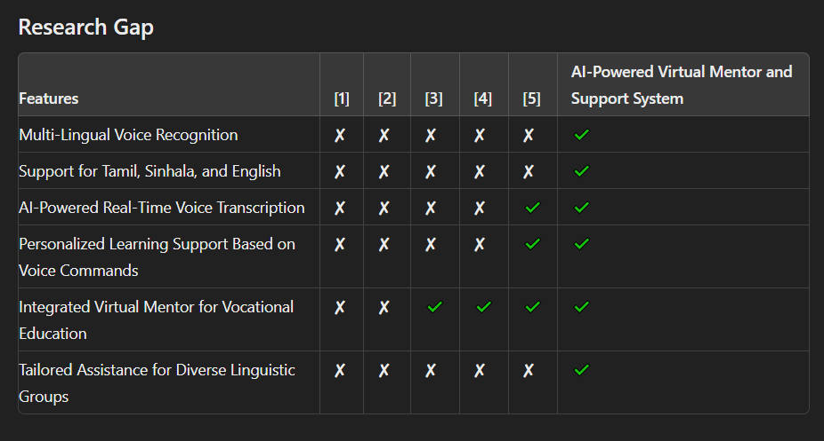
Research Gap
Novelty
Multi-Lingual Voice Recognition
IT21188954 | Saseena M.U.F | 24-25J-185

Slide 28

Research Question
What are the challenges of integrating AI into vocational curricula?
How can AI-powered virtual mentors revolutionize vocational education?
How can AI mentors facilitate continuous skill development?
What are the challenges and solutions in implementing accurate multilingual voice recognition for Tamil, Sinhala, and English in AI-powered virtual mentors for vocational education?
How does the integration of multilingual voice recognition in AI chatbots enhance the learning experience and outcomes in vocational education settings?
IT21188954 | Saseena M.U.F | 24-25J-185

Slide 29

Objective
Main Objective
To develop an AI-powered virtual mentor and support system that enhances vocational education through multi-lingual voice recognition, enabling effective and personalized learning experiences for Tamil, Sinhala, and English-speaking users.
Sub Objective
Develop an AI chatbot for voice-controlled interaction.
Integrate a multilingual speech recognition service.
Implement ASR for Tamil, Sinhala, and English transcription.
Design a user-friendly interface for recording voice notes.
Incorporate a microphone button for easy recording control.
IT21188954 | Saseena M.U.F | 24-25J-185

Slide 30

Methodology
Study Design
Outline the framework for the AI mentor system in vocational education.
Data Collection
Gather relevant educational data for training the AI system
Data Preprocessing
Clean and prepare data for model training.
Model Development
Select and design AI models tailored to the system’s needs.
Training & Evaluation
Train models and evaluate performance using key metrics
IT21188954 | Saseena M.U.F | 24-25J-185

Slide 31
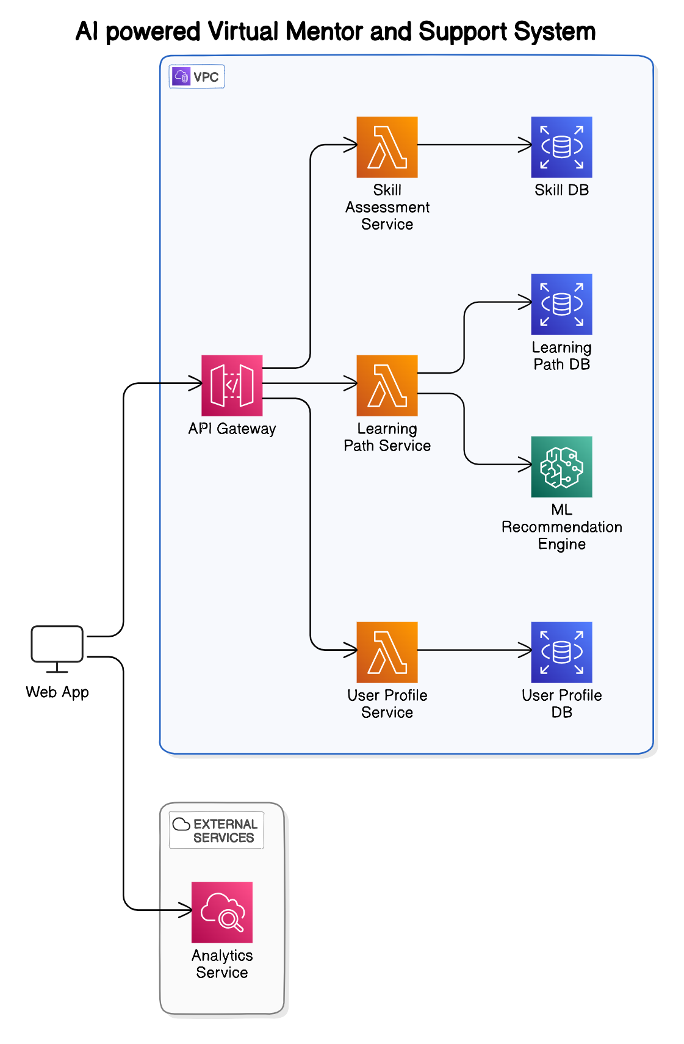
System Diagram
IT21188954 | Saseena M.U.F | 24-25J-185

Slide 32

Component Specific Requirements
Functional requirements
Non-functional requirements
Develop Multi-lingual chatbot in Tamil, Sinhala, and English.
Provides mentorship across various vocational subjects.
Supports Tamil, Sinhala, and English with diverse accent handling.
Accurate transcription of spoken input.
Performance:
Usability
Scalability
Security
Responsive recording control with automatic save and processing.
Seamless access to sessions and notes, with export functionality.
Reliability
IT21188954 | Saseena M.U.F | 24-25J-185

Slide 33

Reference
The Application of Artificial Intelligence Technology in Personalized Teaching in Vocational Education
https://doi.org/10.1109/ICAI50792.2020.9317316
Exploring AI-enabled Intelligent Tutoring System in Vocational Education
https://doi.org/10.1109/TALE.2019.8981689
The Role of AI In Vocational Education: A Systematic Review
https://www.magnascientiapub.com/ai-vocational-education
AI's Impact on Vocational Training and Employability: Innovation, Challenges, and Perspectives
https://doi.org/10.36948/ijfmr.2024.v06i04.24967
Designing an AI-Powered Mentorship Platform for Professional Development
https://doi.org/10.1186/s13634-020-00737-y
IT21188954 | Saseena M.U.F | 24-25J-185

Slide 34

Skill-Based Personalized Learning Path Component
IT20657314
Sujeevan.R
Information Technology
IT20656314 | Sujeevan.R | 24-25J-185

Slide 35
Background
Introduction
Research Question
Research Gap
Objectives
Methodology
IT20656314 | Sujeevan.R | 24-25J-185

Slide 36
Backround
In recent years, personalized learning has become increasingly important, with a focus on adapting educational experiences to meet individual student needs.
Traditional educational systems often struggle to provide tailored learning paths, which can lead to student disengagement and uneven skill development.
AI-driven personalized learning paths can offer real-time adjustments, ensuring that students receive content and challenges appropriate to their skill levels.
IT20656314 | Sujeevan.R | 24-25J-185

Slide 37


Research Question
How can Machine Learning-based systems effectively assess and adapt to a learner's skill level?
What techniques can be used to dynamically recommend personalized modules based on individual performance?
How can real-time adjustments in content complexity improve learner engagement and outcomes?
IT20656314 | Sujeevan.R | 24-25J-185

Slide 38
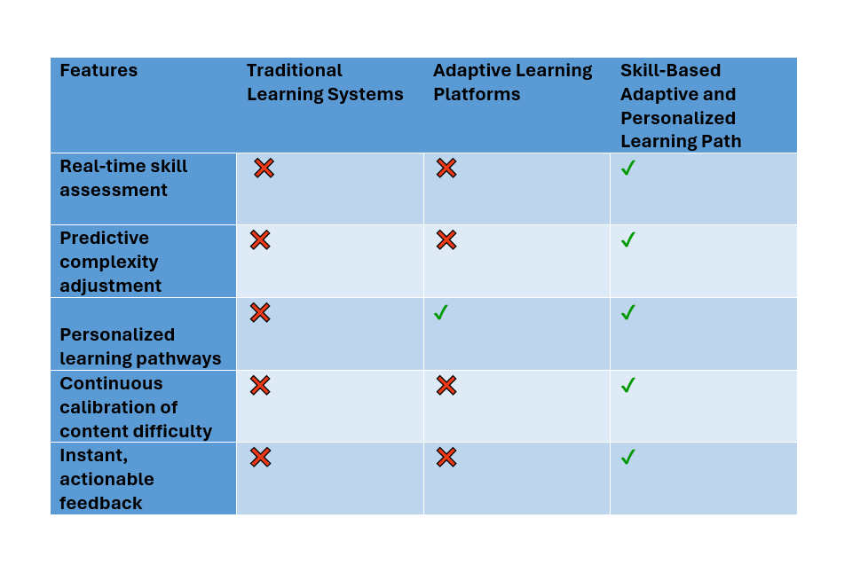
Research Gap
Novelty
Real-time adjustment of learning content complexity based on continuous skill evaluation.
Personalized Pathways: Tailoring learning paths to address individual strengths and weaknesses.
Offers tailored resources such as videos, simulations, or tutorials to match the learner's preferred learning style and needs.
IT20656314 | Sujeevan.R | 24-25J-185

Slide 39



Objectives
Main Objectives
Develop a system that enhances student engagement and learning outcomes through personalized learning paths based on skill level.
Sub Objective
Implement algorithem tools for real-time skill evaluation and baseline analysis..
Develop mechanisms for predictive complexity adjustment.
Integrate progress tracking and feedback to guide learners effectively
IT20656314 | Sujeevan.R | 24-25J-185

Slide 40
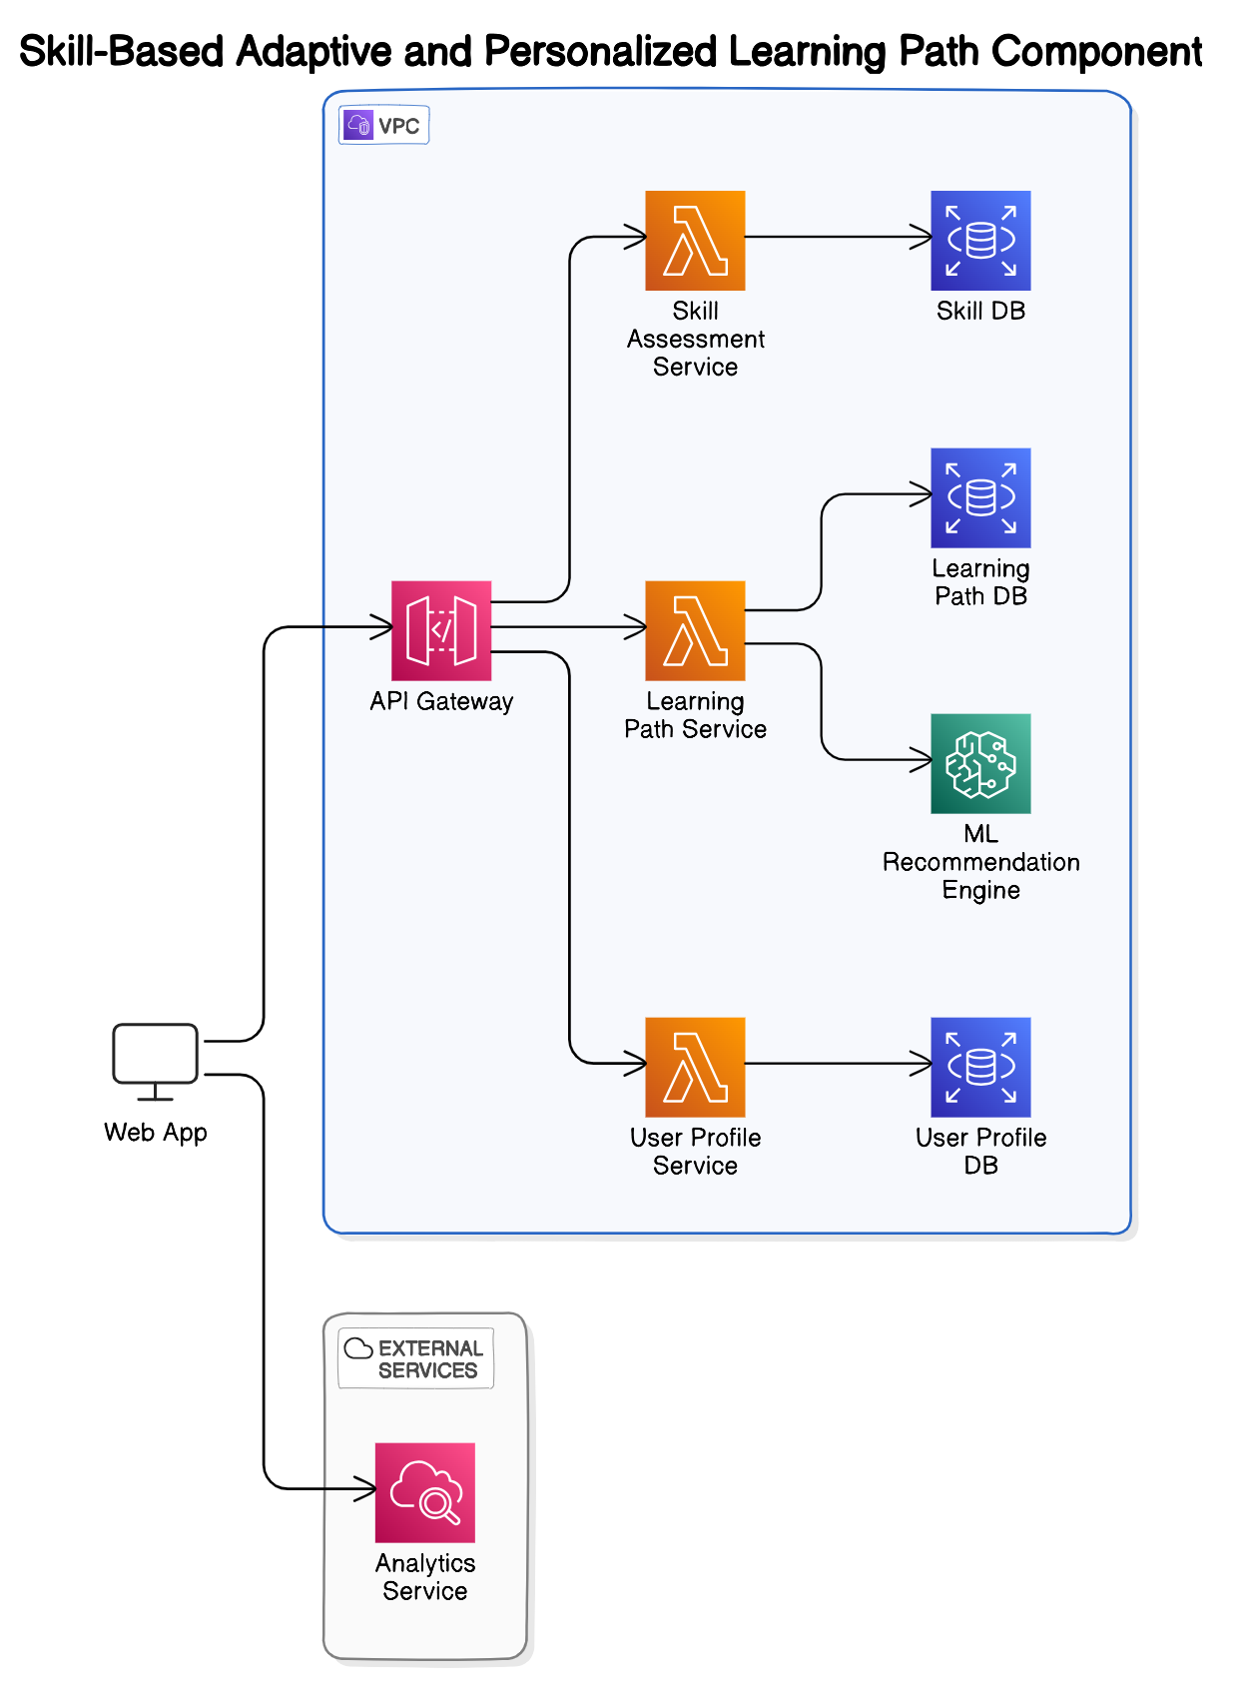
System Diagram
IT20656314 | Sujeevan.R | 24-25J-185

Slide 41
Component Specific Requirements
Functional requirements
Non-functional requirements
Provide personalized learning content based on real-time skill assessment.
Continuously adjust the complexity of tasks and materials.
Offer immediate, actionable feedback to students.
Availability
Reliability
Speed
Performance
Security
Privacy
IT20656314 | Sujeevan.R | 24-25J-185

Slide 42
What Has Been Done
Skill Evaluation Model Development
Model Training and Validation
Baseline Analysis Implementation
Initial Testing
IT20656314 | Sujeevan.R | 24-25J-185

Slide 43
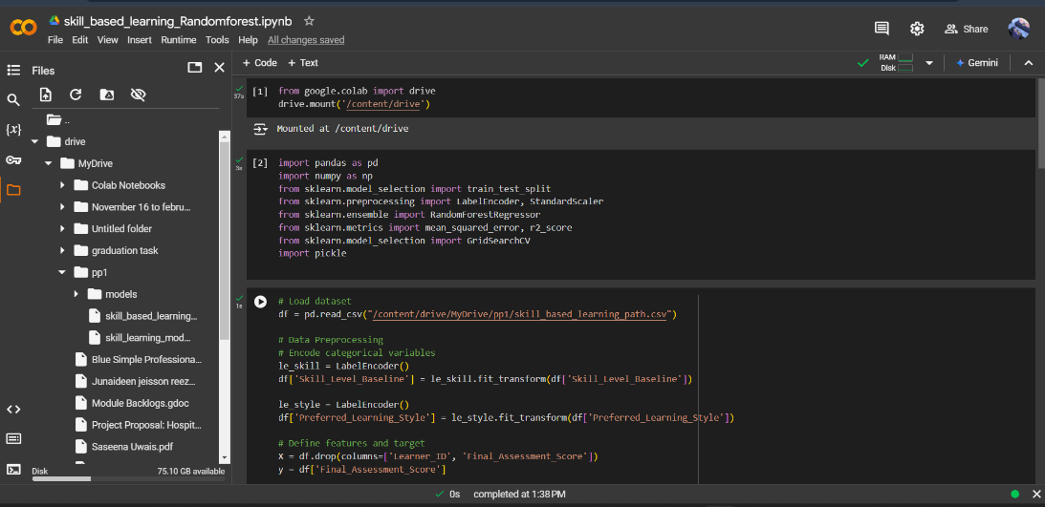
What Has Been Done
IT20656314 | Sujeevan.R | 24-25J-185

Slide 44
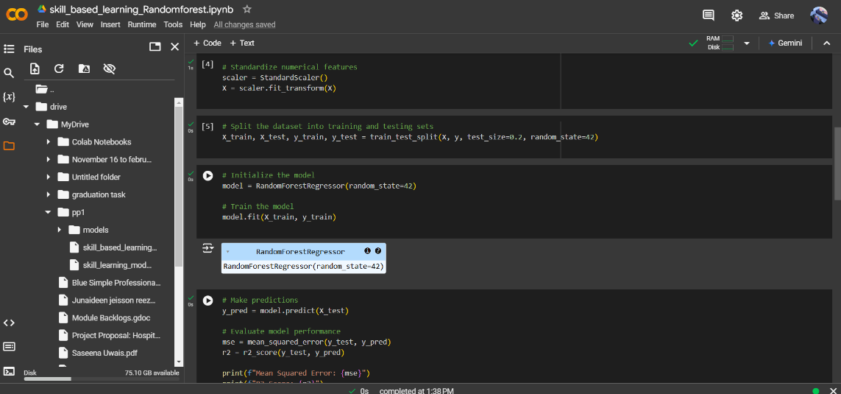
What Has Been Done
IT20656314 | Sujeevan.R | 24-25J-185

Slide 45
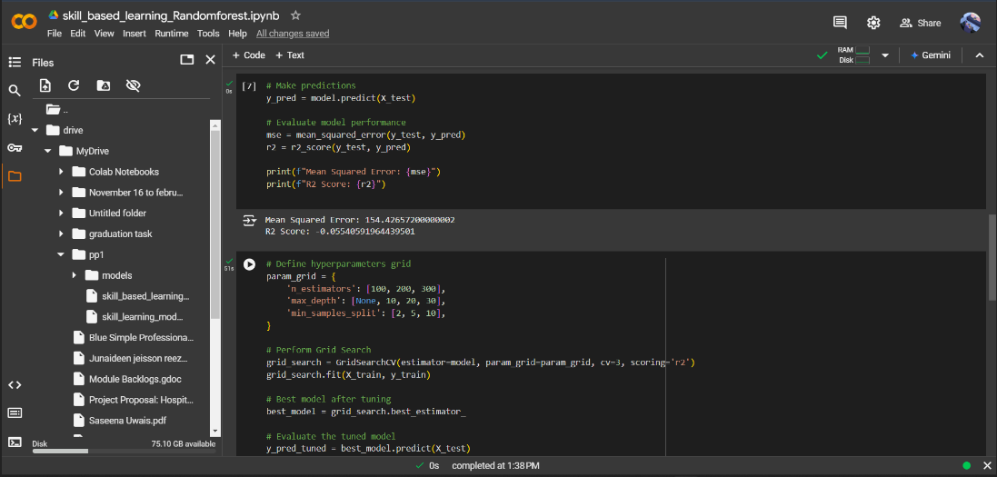
What Has Been Done
IT20656314 | Sujeevan.R | 24-25J-185

Slide 46
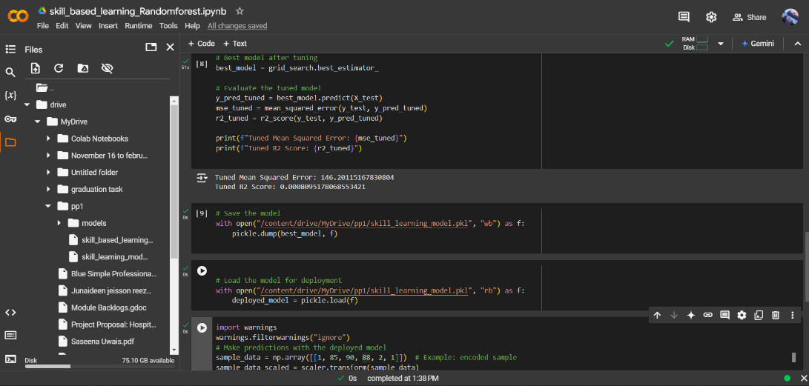
What Has Been Done
IT20656314 | Sujeevan.R | 24-25J-185

Slide 47
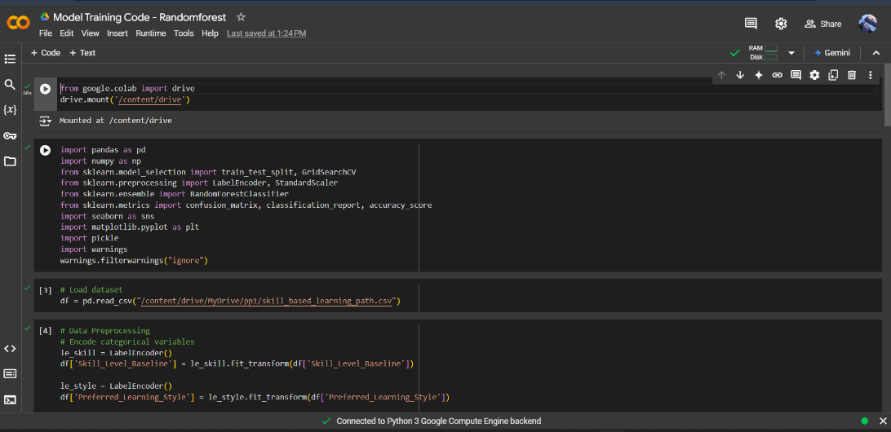
What Has Been Done
IT20656314 | Sujeevan.R | 24-25J-185

Slide 48
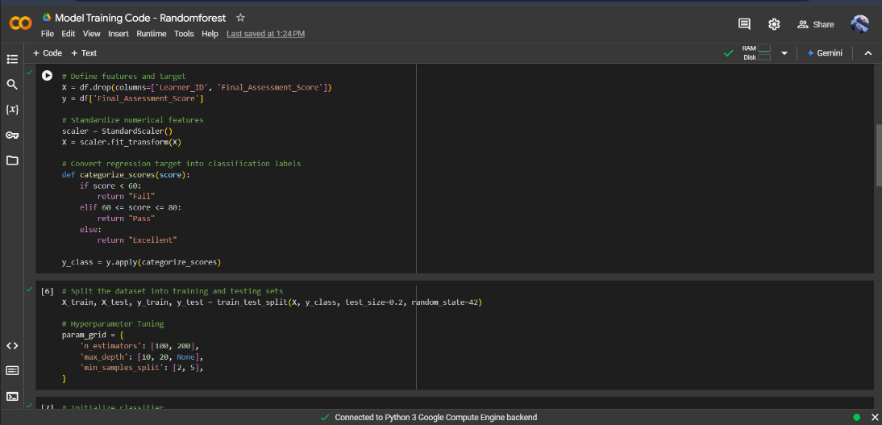
What Has Been Done
IT20656314 | Sujeevan.R | 24-25J-185

Slide 49
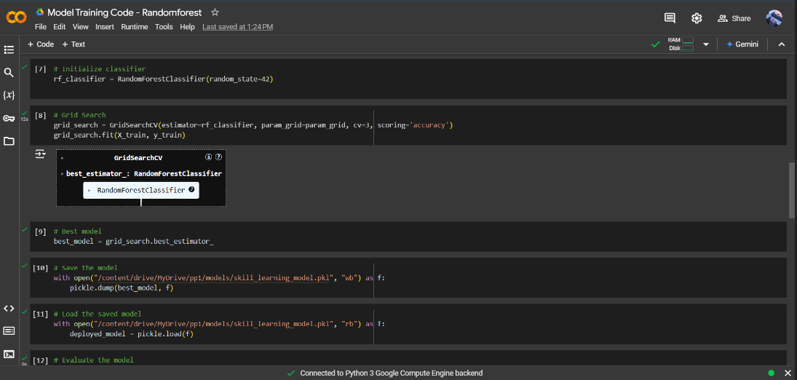
What Has Been Done
IT20656314 | Sujeevan.R | 24-25J-185

Slide 50
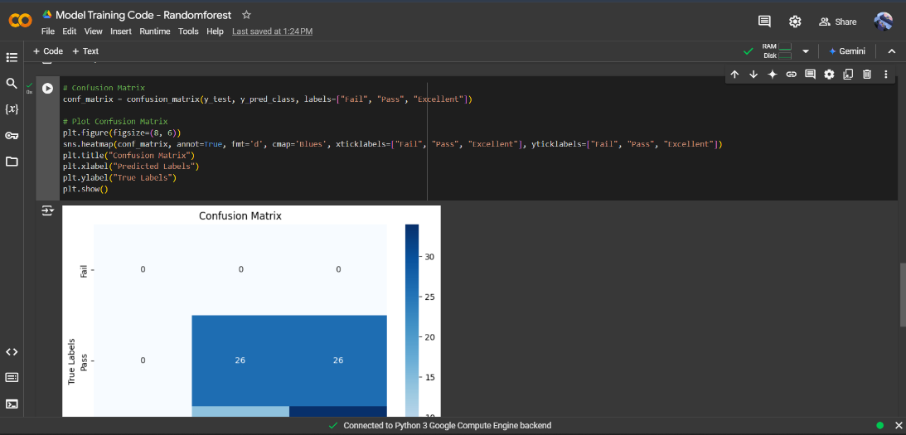
What Has Been Done
IT20656314 | Sujeevan.R | 24-25J-185

Slide 51
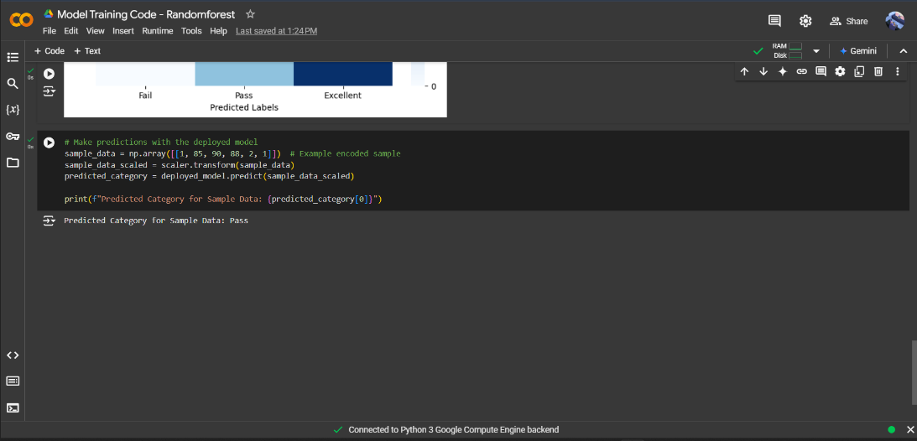
What Has Been Done
IT20656314 | Sujeevan.R | 24-25J-185

Slide 52
What to be Done
User Interface Development
Deploy Model
Improve Model Performance
Enhance Data Quality
Integration with Learning System
Content Personalization Logic
IT20656314 | Sujeevan.R | 24-25J-185

Slide 53
Methodology
Collect student data such as performance scores, course content, and engagement levels.
Clean and prepare the data for training, ensuring it's ready for the AI models.
Choose and build AI models that predict student performance and customize learning paths.
Train the AI models and test their accuracy to ensure they work effectively.
Integrate the AI with the educational platform, making it easy to use for students and teachers.
Allow the AI to adjust the difficulty of tasks based on how students are performing in real-time.
Keep track of student progress, with the AI constantly refining learning paths and materials.
Provide instant feedback to students and suggest ways to improve, using data to enhance the AI.
IT20656314 | Sujeevan.R | 24-25J-185

Slide 54
References
[1]J. Smith, R. Patel, and M. Brown, "AI-Driven Personalized Learning Systems: A Review," in Proc. IEEE Int. Conf. on e-Learning, 2023, pp. 124-129.
[2]A. Gomez, P. Clark, and S. Johnson, "Machine Learning Techniques for Personalized Education," in Proc. IEEE Global Engineering Education Conference (EDUCON), 2023, pp. 678-682.
[3]M. K. Lee and T. Kim, "Personalized Learning in AI-Enhanced Classrooms," in IEEE Transactions on Learning Technologies, vol. 15, no. 3, pp. 788-797, 2023.
IT20656314 | Sujeevan.R | 24-25J-185

Slide 55

Gamification and Game-Based Learning for Vocational Education
IT21347726
Niles A.P
Information Technology
IT21347726 | Niles A.P | 24-25J-185
08/07/24
<number>

Slide 56
Backround
Introduction
Research Question
Research Problems
Objectives
Methodology
IT21347726 | Niles A.P | 24-25J-185

Slide 57
Backround
Why is Gamification and Game-Based Learning for Vocational Education important?
Gamification and Game-Based Learning in vocational education make learning more engaging and effective by integrating interactive elements. This approach enhances skill development, motivation, and real-world application, better preparing students for modern job demands.
IT21347726 | Niles A.P | 24-25J-185

Slide 58
Research Problem
Main reasons why Gamification and Game-Based Learning for Vocational Education is important?
Enhanced Engagement: Increases student motivation and active participation in learning activities.
Practical Skill Development: Provides hands-on, risk-free practice of real-world tasks.
Improved Learning Outcomes: Facilitates better retention and understanding of complex concepts.
Personalized Learning: Adapts to individual student needs, allowing for customized learning paths.
IT21347726 | Niles A.P | 24-25J-185

Slide 59
Objectives
Main Objectives
Develop and implement gamified learning modules tailored for vocational education, incorporating virtual scenarios that address the specific training needs of electricians. Integrate collaborative learning approaches within the game-based environment and establish a robust progress tracking system for both learners and instructors.
Sub Objective
Identify and gamify key concepts in electrical systems.
Develop interactive modules with quizzes and games.
Create and refine realistic virtual scenarios for electricians.
Design team-based challenges and a platform for collaboration.
Implement a tracking system with analytics for monitoring progress and effectiveness.
IT21347726 | Niles A.P | 24-25J-185

Slide 60
System Diagram
Methodology
Tools and Technologies
Requirements
IT21347726 | Niles A.P | 24-25J-185

Slide 61
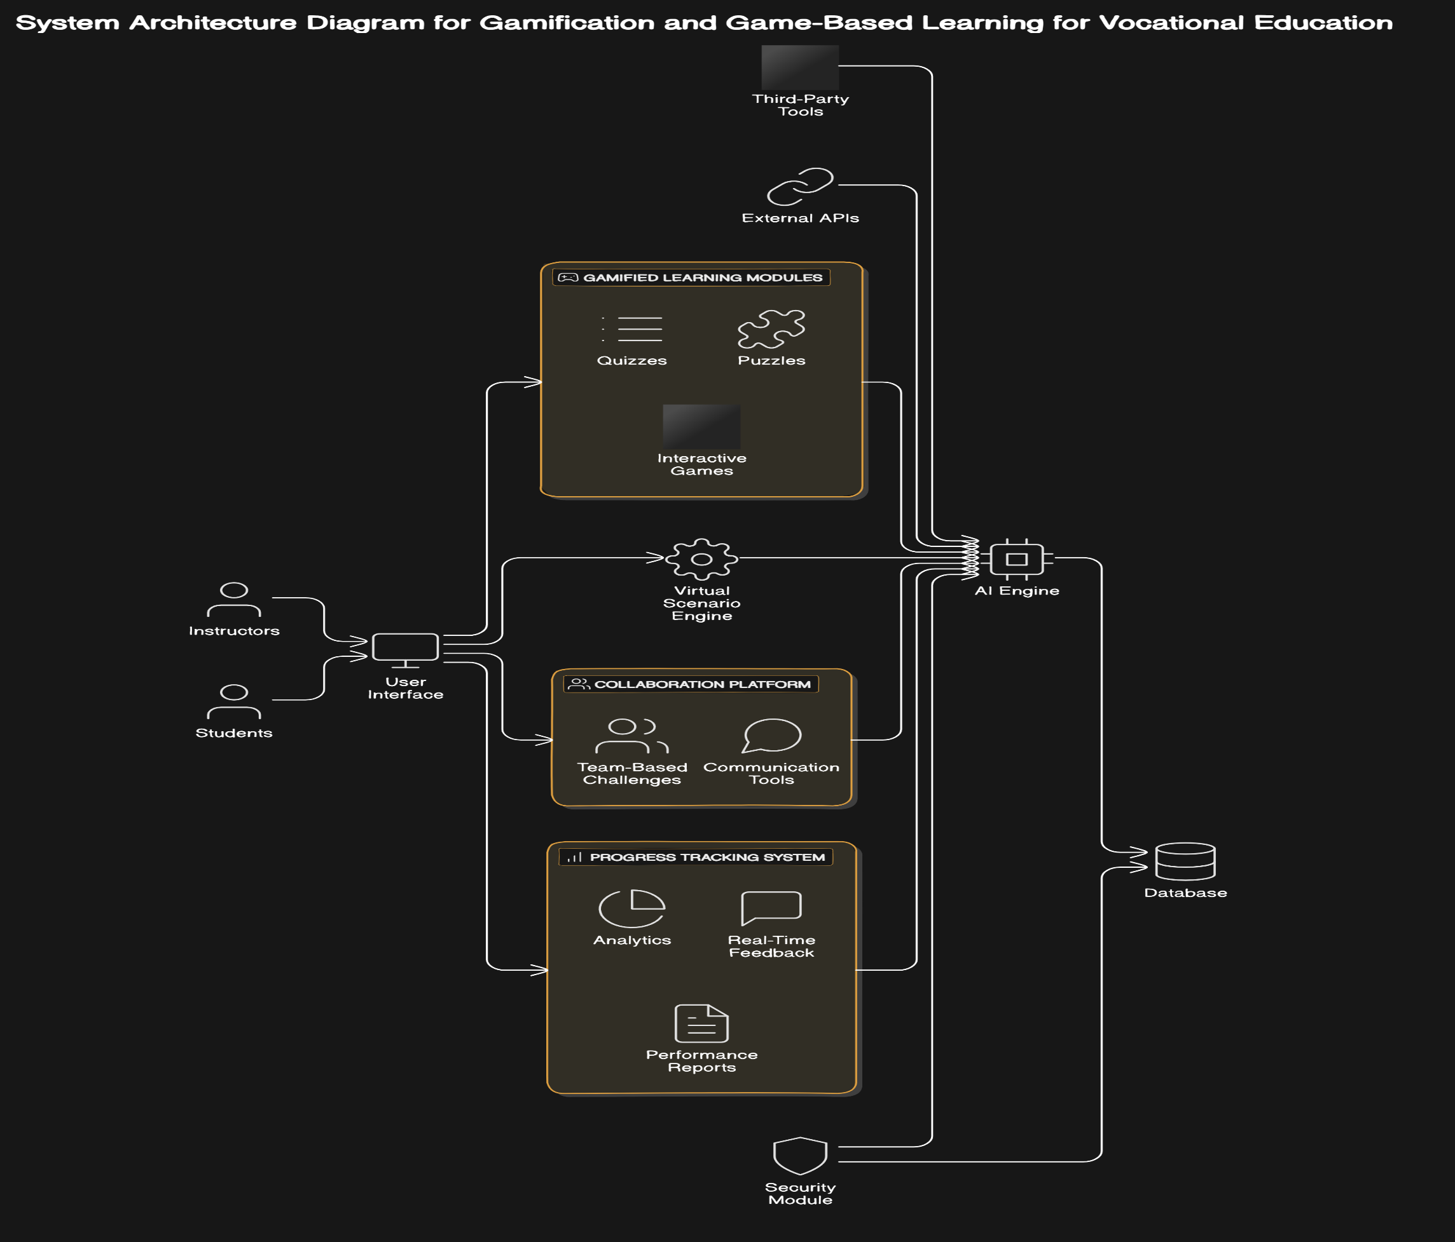
System Diagram
IT21347726 | Niles A.P | 24-25J-185

Slide 62



Tools and Technologies
C#
Python
Django
PostgreSQL
React
GitHub for version control
MS Planner for Project Management
IT21347726 | Niles A.P | 24-25J-185

Slide 63
Project Requirements
Functional requirements
Non-functional requirements
Provide gamified modules with quizzes and puzzles for electrical.
Enable realistic virtual scenarios simulating industry challenges.
Support team-based challenges and learner communication.
Track progress, offer real-time feedback, and generate performance reports.
Scalability
Usability
Performance
Security
Reliability
Compatibility
IT21347726 | Niles A.P | 24-25J-185

Slide 64

Project Management - MS Planner
IT21347726 | Niles A.P | 24-25J-185

Slide 65
Risk Mitigation Plan
Identified Risks:
Technical Challenges: Delays in developing gamified modules and virtual scenarios.
User Adoption Resistance: Reluctance from instructors or institutions to adopt the tool.
Data Security Risks: Potential breaches affecting user data and system integrity.
Scalability Issues: Performance challenges with increasing users.
Mitigation Measures:
Technical Challenges: Employ agile development, regular testing, and contingency plans for potential delays.
User Adoption Resistance: Provide comprehensive training, pilot programs, and emphasize user-friendly design.
Data Security Risks: Use robust encryption, regular audits, and compliance with data protection standards.
Scalability Issues: Implement cloud-based infrastructure to ensure adaptability and reliability.
Execution Plan:
Conduct risk assessments at each project phase.
Implement corrective actions promptly upon identifying risks.
Regularly update stakeholders on risk status and mitigation progress.
Prepare backup solutions for critical failure scenarios.
Maintain documentation for continuous improvement.
Prepared to ensure project success under various challenges.
IT21347726 | Niles A.P | 24-25J-185

Slide 66

Work Done
IT21347726 | Niles A.P | 24-25J-185

Slide 67
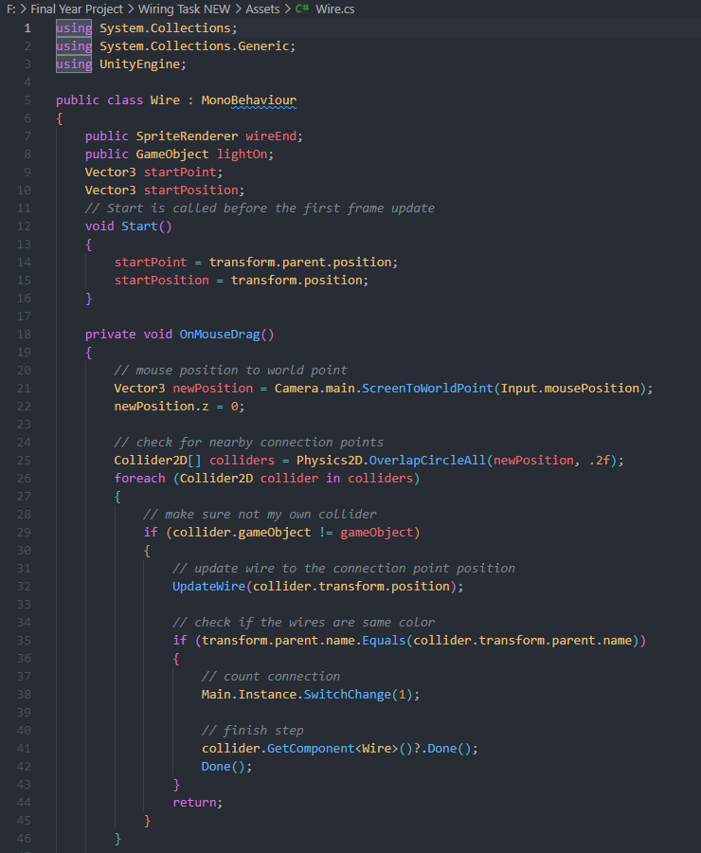
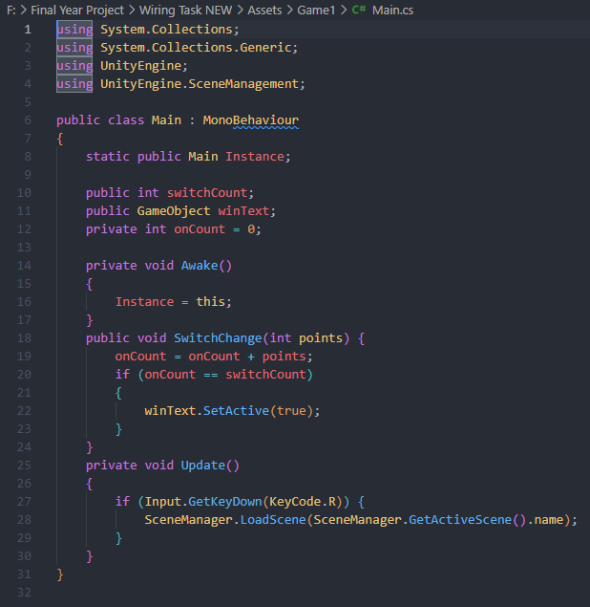
Work Done
IT21347726 | Niles A.P | 24-25J-185

Slide 68
What must be Done
Create more games and challenges
Design game elements (avatars, points, badges, leaderboards)
Progress tracker and generation of performance report
IT21347726 | Niles A.P | 24-25J-185

Slide 69
References
[1] T. H. Hsu, K. H. Lin, and Y. C. Kuo, "Gamification for Vocational Education: An Empirical Study of a Gamified Learning System," IEEE Access, vol. 8, pp. 88910-88922, 2020. DOI: 10.1109/ACCESS.2020.2995947.
[2] M. Al-Ali, H. S. Al-Omari, and F. A. Al-Debei, "The Impact of Game-Based Learning on Vocational Training: A Case Study," IEEE Transactions on Education, vol. 62, no. 3, pp. 154-161, Aug. 2019. DOI: 10.1109/TE.2019.2915110.
[3] Y. G. Li, Y. H. Chen, and J. J. Huang, "Design and Evaluation of a Gamified Learning Platform for Vocational Training," IEEE Transactions on Learning Technologies, vol. 12, no. 1, pp. 60-69, Jan.-Mar. 2019. DOI: 10.1109/TLT.2018.2879476.
[4] L. H. Yang, J. C. Chen, and M. K. Tsai, "Integrating Gamification into Vocational Education: A Study on Learning Outcomes and Engagement," IEEE Transactions on Education, vol. 65, no. 4, pp. 381-388, Nov. 2022. DOI: 10.1109/TE.2022.3165629.
IT21347726 | Niles A.P | 24-25J-185

Slide 70


